Slide 1
What is a Satellite Constellation?
A group of artificial satellites working in concert, with coordinated ground coverage, operating together under shared control.
Do any such constellations exist?
The Iridium Satellite Phone System is the only provider of truly global, truly mobile satellite voice and data solutions with complete coverage of the Earth. It launched 77 satellites between 1997 & 2002.with a commercial satellite phone service live in March 2001.
Iridium has recently replaced its existing 60 satellite constellation by sending 75 Iridium NEXT satellites into space on a SpaceX Falcon 9 rocket over 8 different launches.
On January 11th, 2019 the final 10 Iridium NEXT satellites were delivered to low earth orbit (780km, 480 miles).

Slide 2
Starlink (satellite constellation)
The potential to change what a natural sky looks like

Slide 3
12,000 satellites
SpaceX has plans to deploy nearly 12,000 satellites in three orbital shells
placing approximately:
1600 in a 550-kilometer (340 miles)-altitude shell
2800 at 1,150 km (710 miles)
7500 340 km (210 miles).

Slide 4
Why?
To develop a low-cost, high-performance satellite bus and requisite customer ground transceivers to implement a new space-based Internet communication system
SpaceX intends to provide broadband internet connectivity to underserved areas of the planet, as well as provide competitively-priced service to urban areas.

Slide 5
Does it matter?
Astronomers (you) may agree that a global internet service is a worthy goal.
BUT
Thousands more could go into orbit for the constellations being contemplated by OneWeb, Telesat, LeoSat Enterprises and Amazon’s Project Kuiper and others.

Slide 6
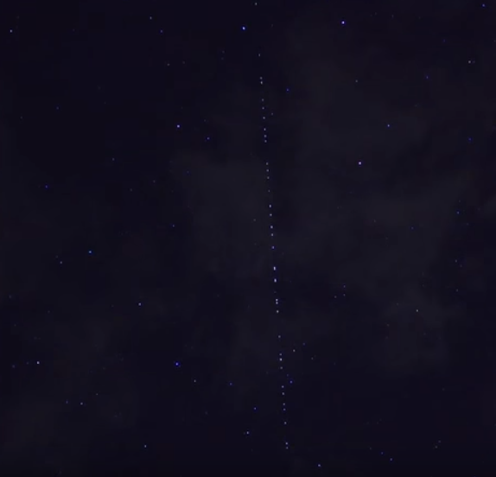
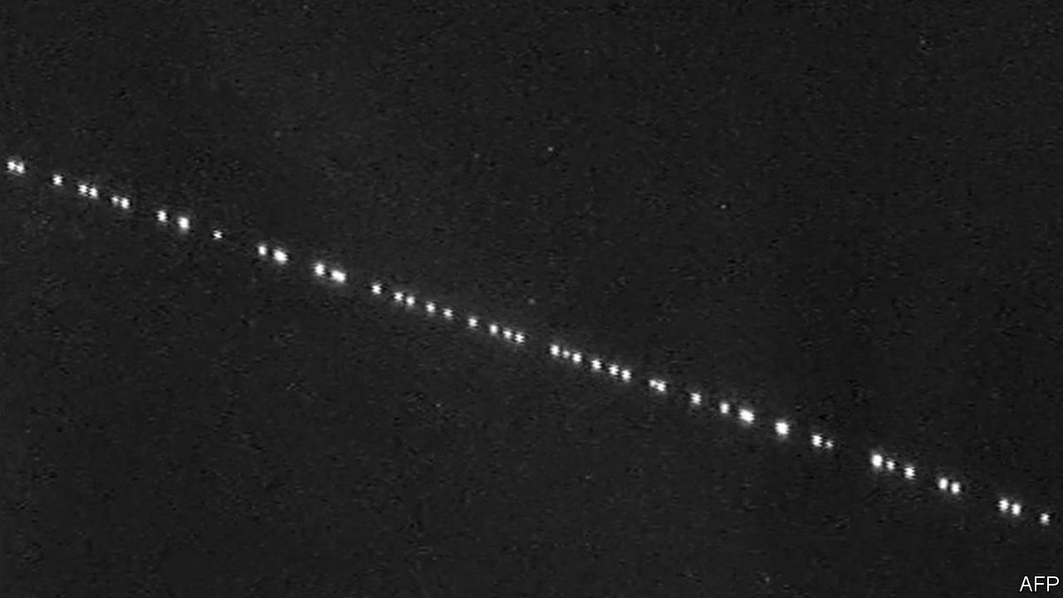
Is that an exaggeration?
On the 24 May 2019 the first 60 operational satellites were launched into the mid orbit for SpaceX’s Starlink system.

Slide 7


https://www.youtube.com/watch?v=T6v47CmRA7A

